Slide 1
Data, Data, and More Data…
CS 5540
(Rao)

Slide 2
Types of Data
Unstructured
Semistructured
Structured

Slide 3
Unstructured Data
Textual content – mainly for human understanding/cognition
HTML web pages
PDF files, MS Word files
Emails
Posts on social media sites such as Facebook and Twitter
Blogs
Text messages

Slide 4
Structured Data
There is a defined structure on how the data should be stored and represented
Relational databases store data in tables
SSN | Name | Age | Salary | Phone
1234 | John Doe | 25 | 100000 | 123-45678
2345 | Jim Doe | 35 | … | …
… | … | … | … | …
Employee
Course | Department | SSN
CS490JU | CSEE | 5678
… | … | …
… | … | …
… | … | …
Tables
Courses

Slide 5
Example
List the SSN and salary of each employee who teaches a course along with the course number and sort the results by salary -- low to high
SELECT E.SSN, E.Salary, C.Course
FROM Employee as E, Courses as C
WHERE E.SSN = C.SSN
ORDER BY E.Salary
Notes:
Table alias

Slide 6
Semistructured Data
No need of a fixed structure/schema
Data can have partial/loose structure
Example
XML data model
RDF data model; also referred to as “schema-free”
JSON

Slide 7
What is Big Data?
Velocity
Volume
Variety
Big Data!
Other V’s: Veracity, Value, …
Notes:
Veracity

Slide 8
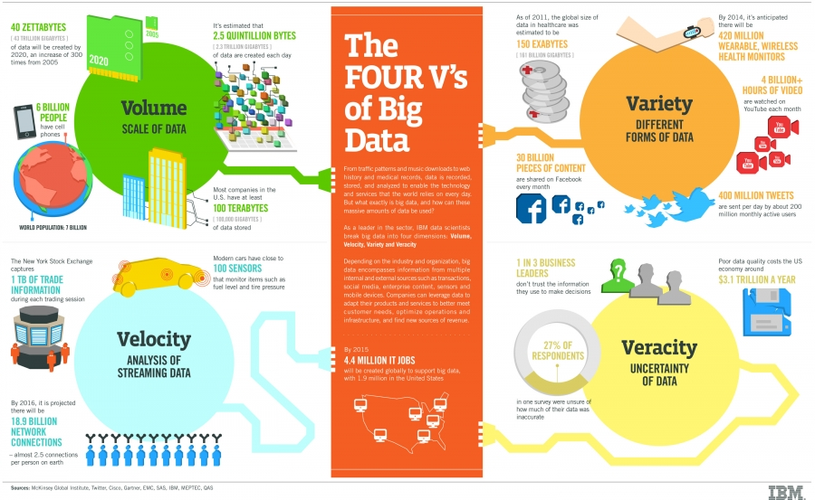
Nice Illustration

Slide 9
Key Points
Volume
Very large amounts of data
Petabytes (10¹⁵ bytes) and more
Variety
Structured + unstructured + semistructured data
Velocity
High rate of arrival of data
Stock quotes, Twitter tweets, sensor readings, web clicks, and many more

Slide 10
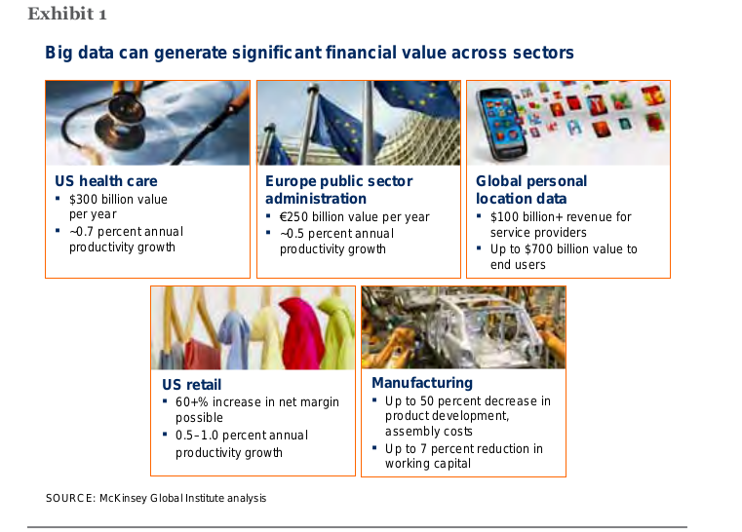
Impact?

Slide 11
A Tweet
dbs@DBS:~$ cat ~/Tweets/json/test.json
{"contributors":null,
"text":"ポカーン。",
"geo":null,
"retweeted":false,
"in_reply_to_screen_name":null,
"truncated":false,
"lang":"ja",
"entities":{"urls":[],"hashtags":[],"user_mentions":[]},
"in_reply_to_status_id_str":null,
"id":289429398778687488,
"source":"<a href=\"http://twitter.com/download/iphone\" rel=\"nofollow\">Twitter for iPhone<\/a>",
"in_reply_to_user_id_str":null,
"favorited":false,
"in_reply_to_status_id":null,
"retweet_count":0,
"created_at":"Thu Jan 10 17:52:00 +0000 2013",
"in_reply_to_user_id":null,
"id_str":"289429398778687488",
"place":null,
"user":{
"location":"",
"default_profile":true,
"statuses_count":1885,
"profile_background_tile":false,
"lang":"ja",
"profile_link_color":"0084B4",
"profile_banner_url":"https://si0.twimg.com/profile_banners/459434688/1357637886",
"id":459434688,
JSON: name/value pairs, arrays

Slide 12
"following":null,
"favourites_count":0,
"protected":false,
"profile_text_color":"333333",
"description":"そば屋にいるね",
"verified":false,
"contributors_enabled":false,
"profile_sidebar_border_color":"C0DEED",
"name":"まさひろ。",
"profile_background_color":"C0DEED",
"created_at":"Mon Jan 09 17:22:25 +0000 2012",
"default_profile_image":false,
"followers_count":113,
"profile_image_url_https":"https://si0.twimg.com/profile_images/2093645100/image_normal.jpg",
"geo_enabled":false,
"profile_background_image_url":"http://a0.twimg.com/images/themes/theme1/bg.png",
"profile_background_image_url_https":"https://si0.twimg.com/images/themes/theme1/bg.png",
"follow_request_sent":null,
"url":null,"utc_offset":null,z
"time_zone":null,
"notifications":null,
"profile_use_background_image":true,
"friends_count":104,
"profile_sidebar_fill_color":"DDEEF6",
"screen_name":"HiSoftbank",
"id_str":"459434688",
"profile_image_url":"http://a0.twimg.com/profile_images/2093645100/image_normal.jpg",
"listed_count":0,
"is_translator":false},
"coordinates":null
}
Notes:
Friends_count – two way

Slide 13
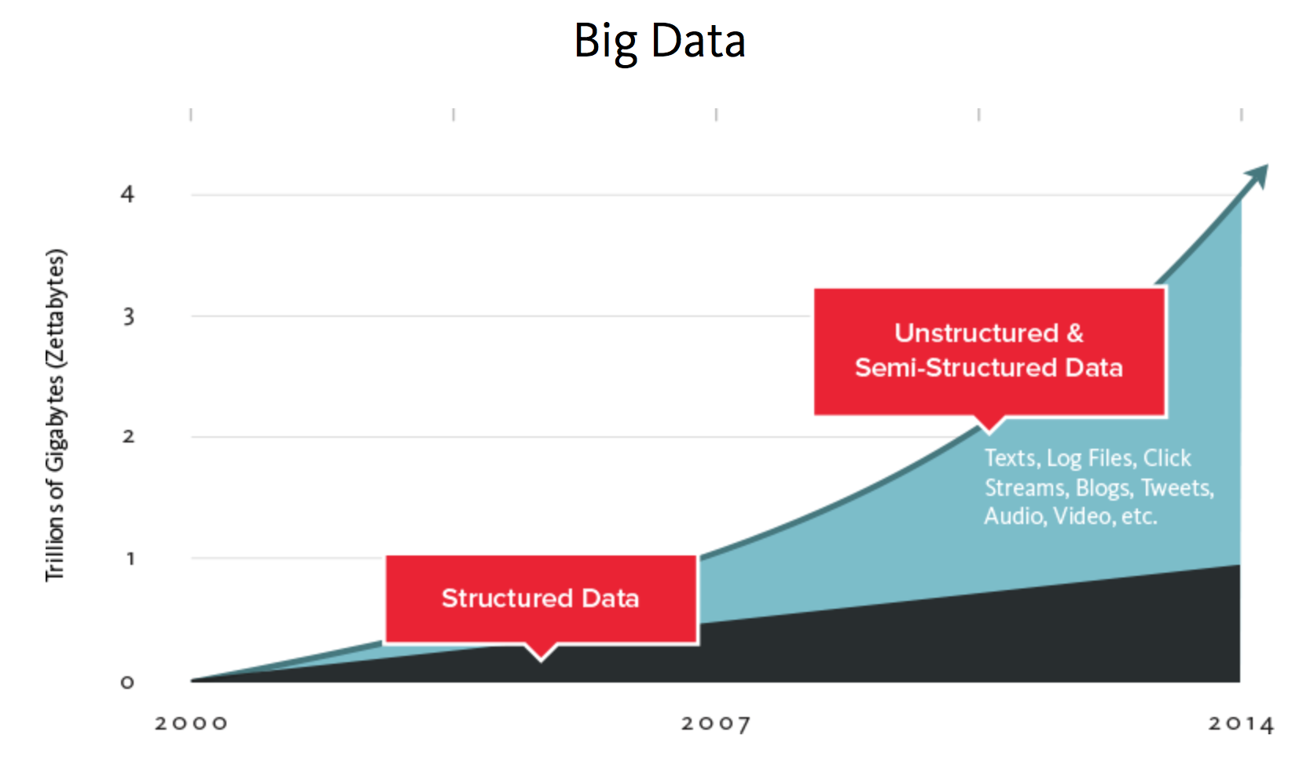
Data Explosion
http://www.couchbase.com/nosql-resources/what-is-no-sql
Notes:
NoSQL = different from tabular representation + scale-out architecture + not-ACID
Flexible schema, can change over the lifetime of the data – RDBMS – too rigid for the nature of big data
NoSQL → key-value/wide-column store/document DBs/graph databases

Slide 14
Benefit of Big Data
Big data
Structured
Unstructured
Gain insights
Big data analytics
Better decision making
Improved revenues
Lower costs
Semistructured
Mining, statistical analysis, machine learning

Slide 15
Impact of Big Data

Slide 16
Impact of Big Data
“Big data technologies will be transformative in every sphere of life.”¹
According to IBM²
“Healthcare: 20% decrease in patient mortality by analyzing streaming patient data”
“Telco: 92% decrease in processing time by analyzing networking and call data”
“Utilities: 99% improved accuracy in placing power generation resources by analyzing 2.8 petabytes of untapped data”
¹J. Podesta, P. Pritzker, E. Moniz, J. Holdren, and J. Zients. Big Data: Seizing Opportunities, Preserving Values.
http://www.whitehouse.gov/sites/default/les/docs/big_data_privacy_report_5.1.14_final_print.pdf, 2014.
² http://www-01.ibm.com/software/data/bigdata/industry.html

Slide 17
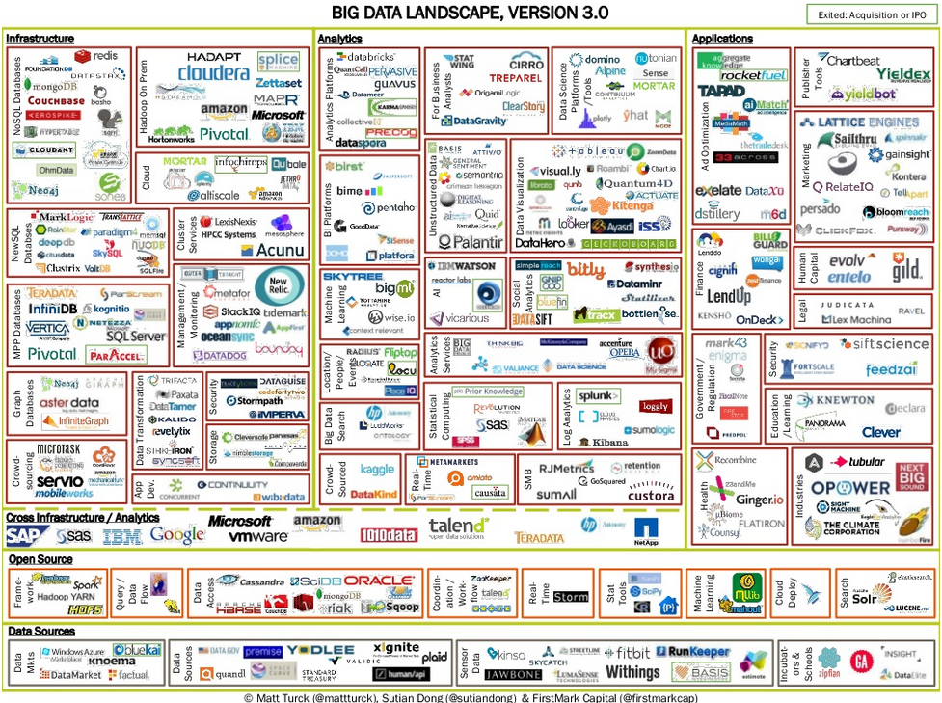
The Big Data Landscape

Slide 18
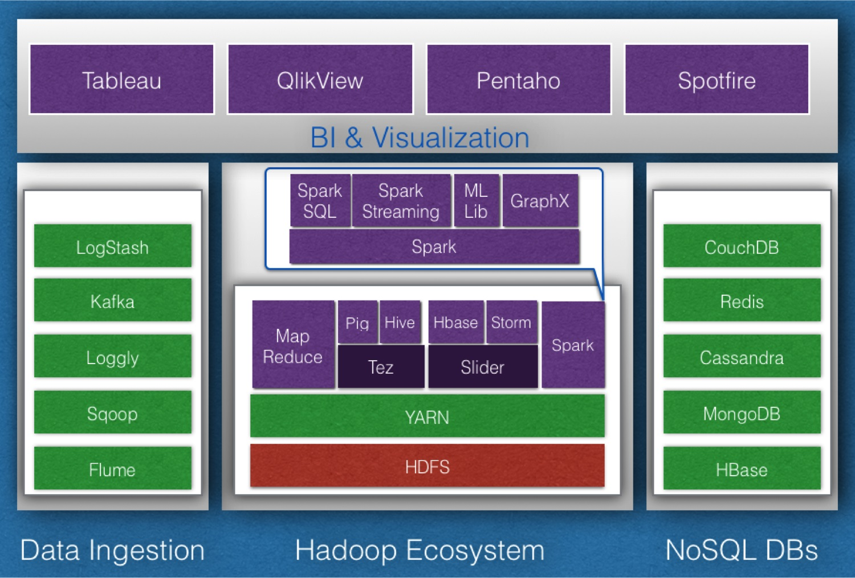
Bird’s Eye View of the Big Data Ecosystem
http://synerzip.com/wp-content/uploads/2013/08/Hadoop-Ecosystem1.jpg

Slide 19
Apache Hadoop
Open-source framework for storing and processing large amounts of data on a cluster of machines
http://hadoop.apache.org
MapReduce Framework
Write parallel programs, execute the programs on a cluster of machines
Hadoop Distributed File System (HDFS)
A distributed file system to store large number of large files using a cluster of machines

Slide 20
File System Basics
A file has two main parts
Metadata
Name of the file, creation time, size, permissions, pointers to data blocks
Data blocks
Actual content of the file is broken down into equal-sized blocks
Notes:
See board

Slide 21

HDFS
Source: http://hadoop.apache.org/docs/stable/images/hdfsarchitecture.gif

Slide 22
MapReduce Model
Intermediate
data
output
data
map
reduce
data
map
reduce
data
map
reduce
data
map

Slide 23
IBM BigInsights
http://bigdatauniversity.com/
Need to create an IBM universal id
Free download
VMWare image is available
SUSE Linux
Notes:
Start with simple Linux instances, do some file operations

Slide 24
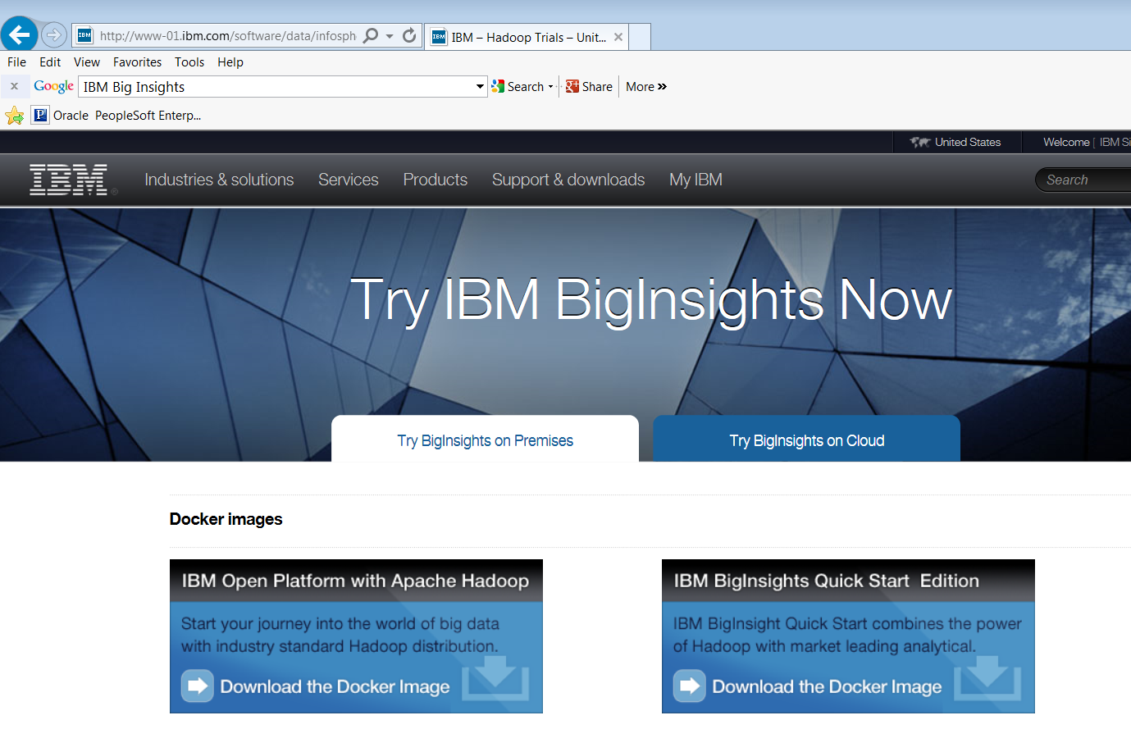
Getting Started
http://www-01.ibm.com/software/data/infosphere/hadoop/trials.html

Slide 25
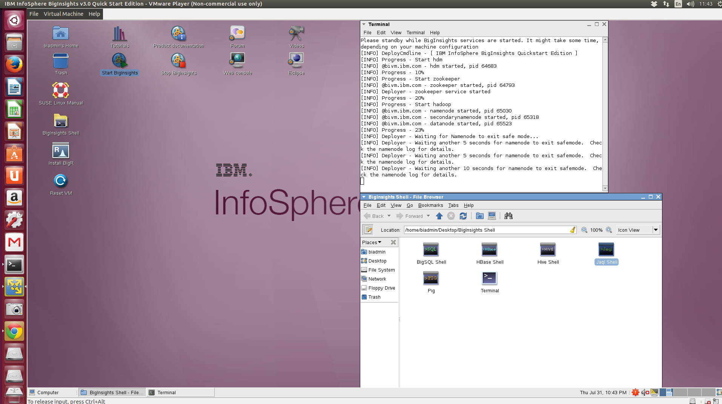
Ready, Set, Go!
click any of these

